Slide 1
Time/Attention Management and Study Tips for Ridiculously Busy OL Students
Fall 2023

Slide 2
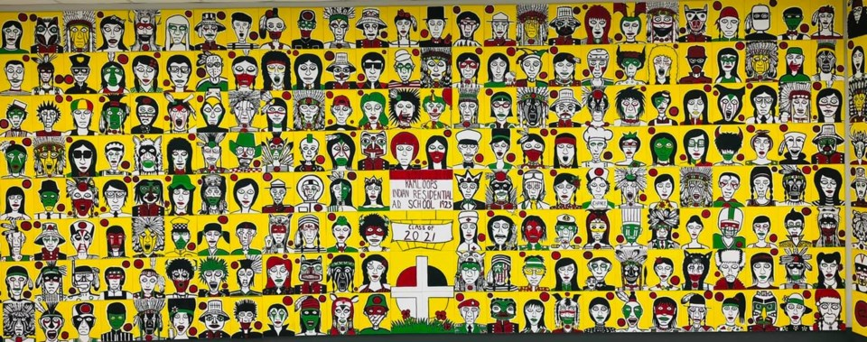
Artwork by Johnny Bandura
Thompson Rivers University campuses are on the traditional lands of the Tk'emlúps te Secwépemc (Kamloops campus) and the T’exelc (Williams Lake campus) within Secwépemc'ulucw, the traditional and unceded territory of the Secwépemc. Our region also extends into the territories of the St’át’imc, Nlaka’pamux, Nuxalk, Tŝilhqot'in, Dakelh, and Syilx peoples.
Notes:
3 mins
The artwork is by Johnny Bandura, who channeled his feelings about the discovery of 215 children’s bodies at the former Kamloops Indian Residential School into a piece of art, painting 215 images of what each child may have become when he or she grew up.
Jenna’s spoken word land acknowledgement

Slide 3
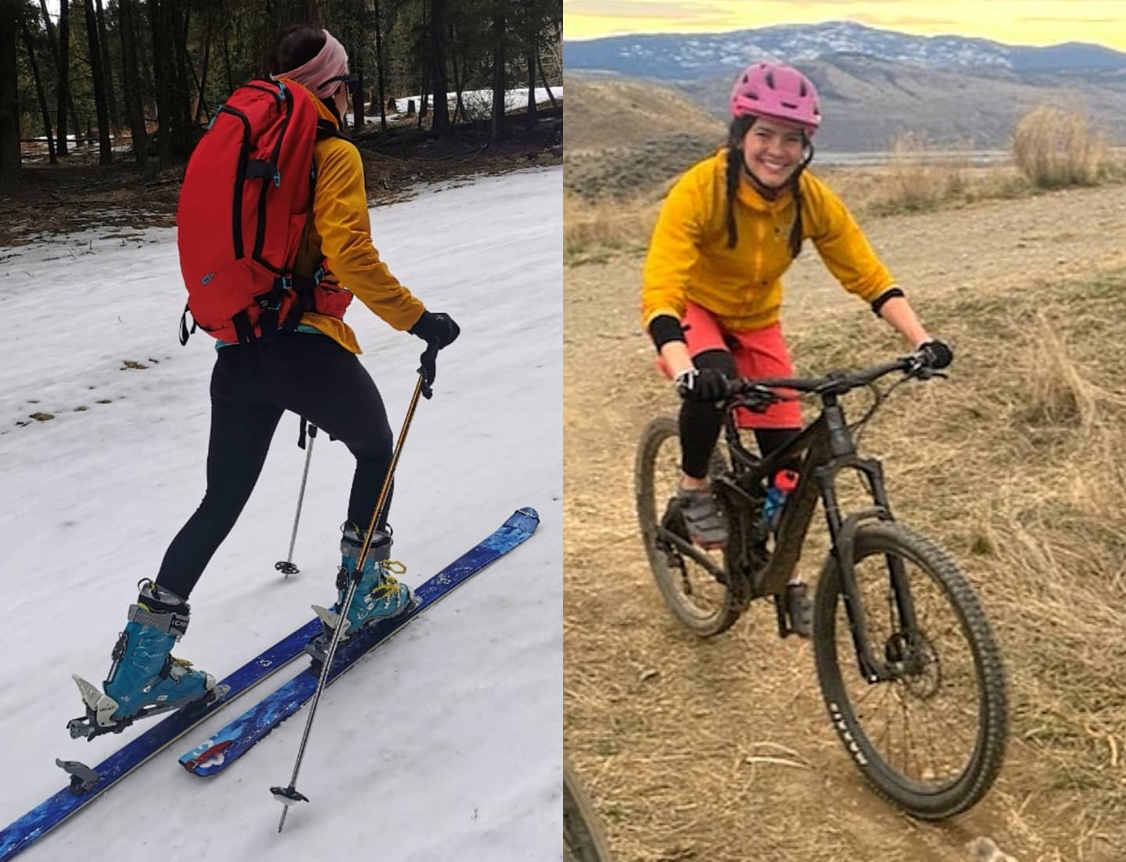
Introductions
Who am I?
Writing Centre Coordinator, Assistant Teaching Professor
Step-mum, social justice warrior, mountain-adorer, mountain-biking fanatic, arbitrary hugger, book-consumer, burger-and-beer afficionado; never-not-awkward

Slide 4
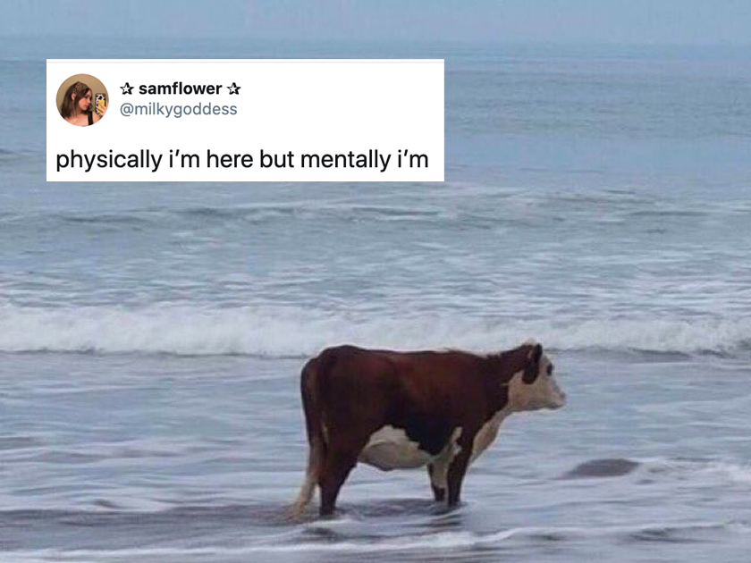
Overview
Time/Attention Management
Dealing with Procrastination
Improving Focus and Attention
Study Better (to save you time!)
Reading Tips

Slide 5
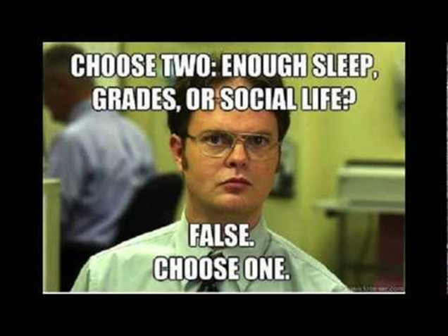
Some questions to get us started…
What are the academic and extracurricular expectations of your course?
What are the biggest challenges YOU face as an OL student?
What are some of the resources at TRU that you can access as an OL student with these challenge areas?

Slide 6
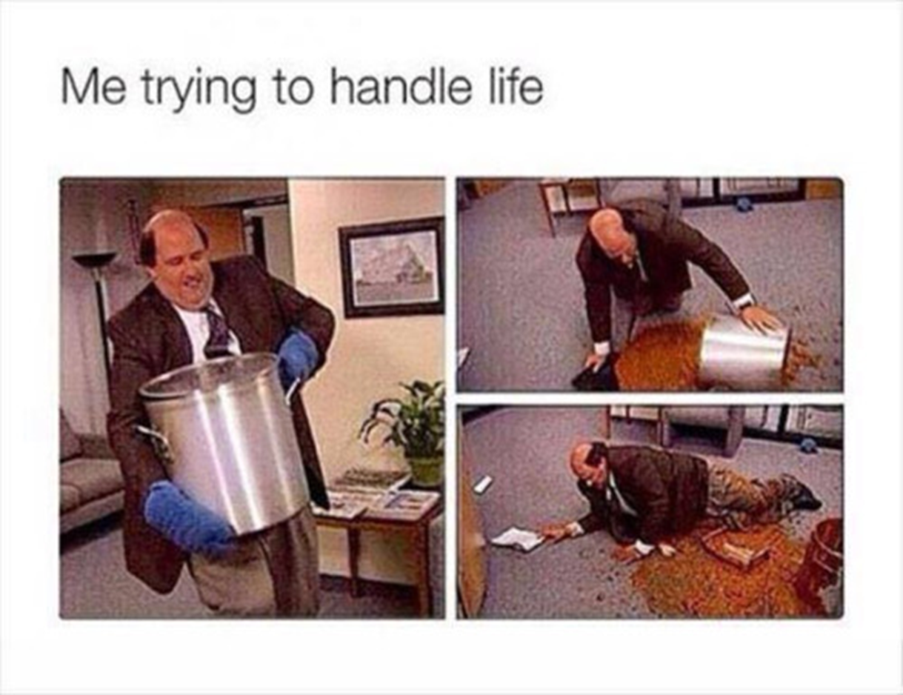

Slide 7
Dealing with Procrastination
Discover your style
Dreamer
Worrier
Crisis-Maker
Defier
Over doer/giver
Perfectionist
What kind of procrastinator are you?
Break things down into doable steps; plan backwards!
“Eat the frog”
Get an accountability partner/body double
Kiddo, classmate, partner, your mom

Slide 8
What if I’m having a tough time staying focused while studying?
Adam Grant’s attention management (2019):
Productivity struggles are often caused by a lack of MOTIVATION, not efficiency!
Prioritize the people and PROJECTS that matter
WHEN: reorder your tasks based on attention
“Attention residue”: boring tasks seem harder after an interesting one!
Save your most exciting task as a reward
Figure out when you concentrate the best
Analytical work = peak alertness (THIS IS YOUR BEST STUDYING OR READING TIME!)
Routine tasks = lowest energy
Creative work = nonlinear thinking
Consider “Manager Days” and “Maker Days”
Train yourself to work and study in shorter intervals

Slide 9
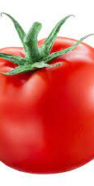
Pomodoro Technique
Useful for writing, reading, and studying…or any kind of repetitive work
What is it?
Choose your task and estimate the total time it will take
Set a timer for 25 minutes; start working!
Take a 5-minute break for energy renewal
After 4 pomodoros, take a 20–30-minute break
Why does it work?
25 minutes is long enough to accomplish work, but not too long that it feels overwhelming!
How could you combine it with Adam Grant’s suggestions?

Slide 10
Time Management Life Hacks
Don’t multi-task!
Use an Assignment Calculator
Group similar tasks
Writing, reading, projects
Track where you spend your time
Eliminate your time-wasters
Decrease distractions
Phone/internet tabs

Slide 11
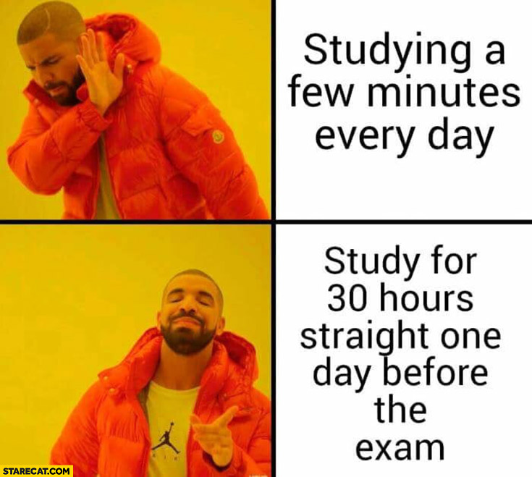

Slide 12
Visualization
Retrace the path
The more often you recall, the easier it is to find!
Group information
Information is easier to recall if you can associate it with other similar information
Review quickly and immediately
The more you do this, the stronger the “path”
Take control
Pay attention, categorize, and make connections…in other words, make your learning ACTIVE!

Slide 13
Quizlet
What is it?
Web-based app to help students study information through interactive tools and games
Why is it useful?
Flexible, customizable
You can review anywhere
You can test yourself
What are some of the drawbacks?
The ads on the free version are distraction
If you use flashcards created by someone else, the information might not be correct
It’s FREE!

Slide 14
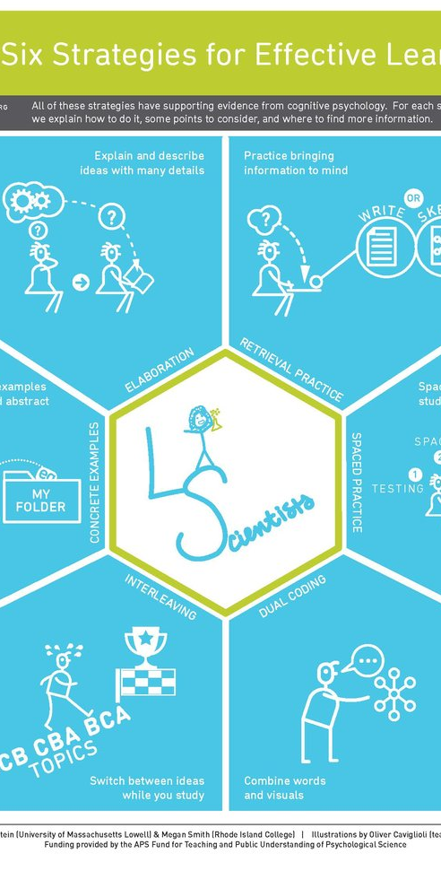
6 MOST effective study techniques
Watch the video: https://www.youtube.com/watch?v=CPxSzxylRCI
What are the 6 effective study techniques outlined in the video?
Spaced Practice
Interleaving
Elaboration
Concrete Examples
Dual Coding
Retrieval Practice

Slide 15
What works is not always obvious…or easy!!
One of the most common study strategies used by students is to re-read, despite the fact that research shows it is one of the LEAST effective learning strategies!
So, WHY?
We like to trick ourselves into thinking we know ourselves pretty well
It feels like we are learning: reading a passage the 2nd or 3rd time feels easier than the 1st time
We read it faster and it feels more familiar, and this makes us feel like we’ve learned something… but this doesn’t really help us on the test
By contrast, several of the most effective strategies can look and feel worse at the beginning: retrieval practice, interleaving, and spaced practice
But they have MUCH greater long-term benefits!

Slide 16
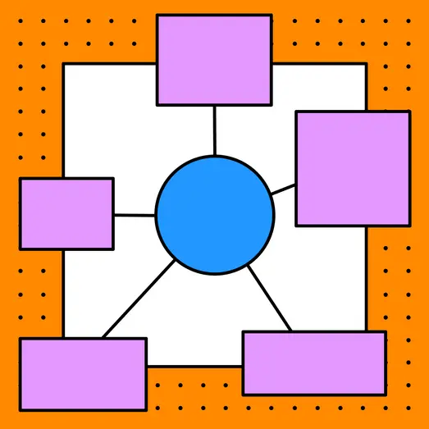
Concept Mapping
Concept maps/word webs/mind maps/cognitive maps
Why are they useful?
Convert complex information into organized, meaningful displays
Visually depict a system of relationships
Utilize “dual coding” strategies (words + visuals)
Purpose?
Pull background information forward
Find out how well knowledge is remembered
Generate new ideas and creative thinking
Reorganize notes

Slide 17
Study hacks for busy students
Connect what you’re studying in the classroom to your life experience, the field, or what you’re learning in other classes
Pick your studying environment
Don’t study in bed!
Let’s talk about background noise
Try out a caffeine nap
Think out loud and move around
Are you able to form a study group? Connect with a classmate?
Don’t cram the night before; get 6-8 hours of sleep!
Your first 2 cycles (app. 90 minutes each) -your deepest sleep (NREM)- squeezes out your brain sponge

Slide 18
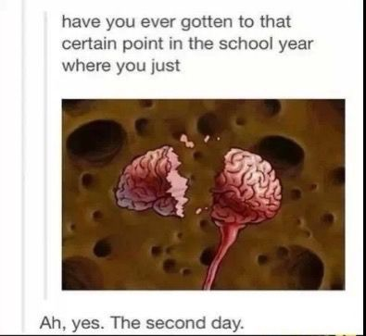

Slide 19
Academic reading hacks
Break your reading into 3 parts:
1) Preview
Look for summary statements, headings, familiar concepts, drawings
Ask questions about the material
wakes up your brain
Skip around (try starting with the conclusion)
2) Read
Practice “skimming” (general overview) and “scanning” (finding specific information)
Create mini-reviews and summaries after each section
Read out loud!
Annotate
Find topic; mark with “T”; number main points or arguments; make notes in margins
3) Review
Within 24 hours!
Use another text (YouTube videos, podcasts)
Utilize flashcards/Quizlet + short study sessions (Spaced Practice + Pomodoro)

Slide 20
Questions? Comments?

